Slide 1
VIVADO HLS 設計
Include File (.h)
Function File (.c or .cpp) (IP)
Testbench File (.c or .cpp)

Slide 2
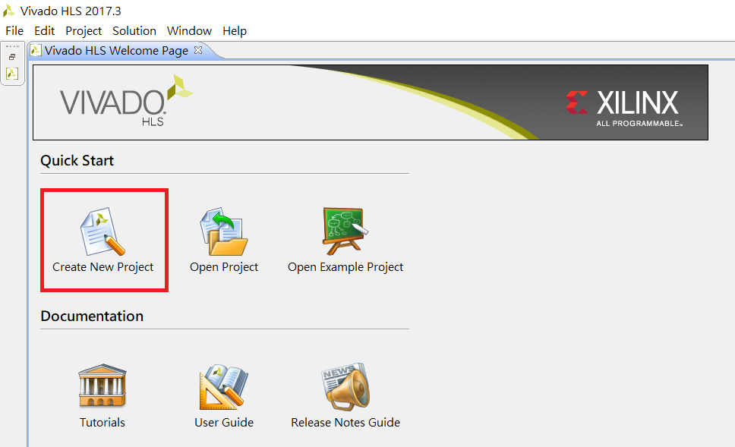
Step01: Create Project

Slide 3
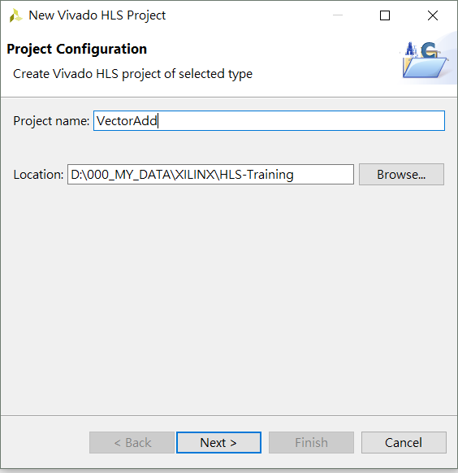
Step02: Enter project name and location

Slide 4
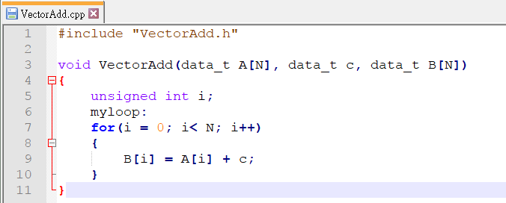
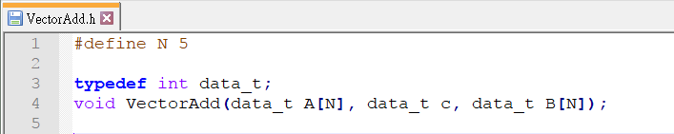
Step02: Source code

Slide 5
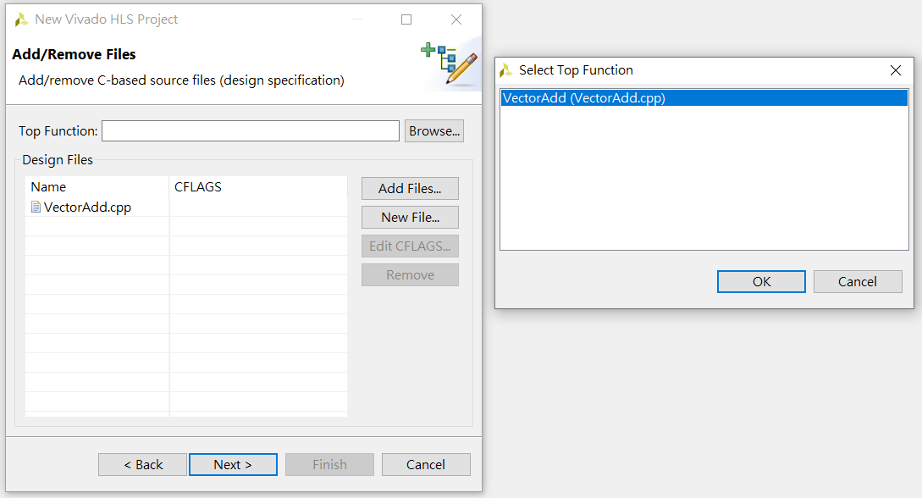
Step03: Add source code
Click Add Files: add function file
Then click Browse, select VectorAdd, click OK

Slide 6
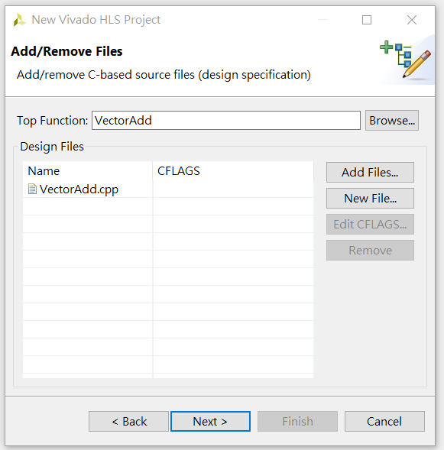
Step04: Click Next

Slide 7
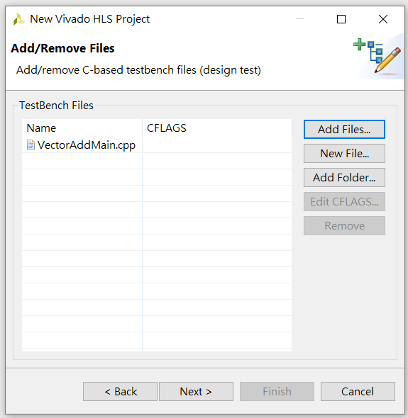
Step0: add Testbench File

Slide 8
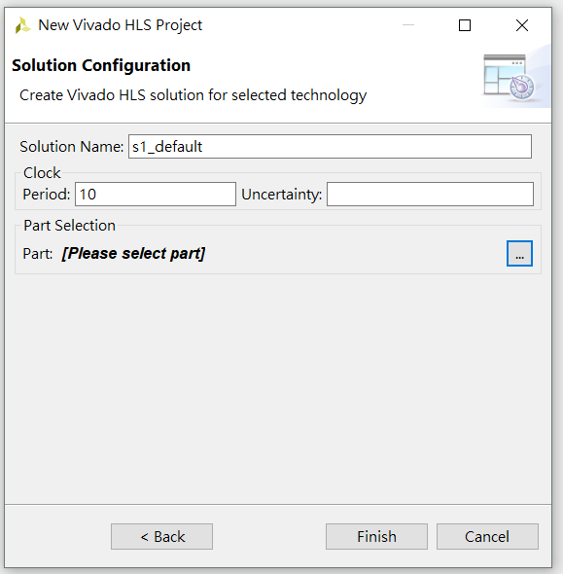
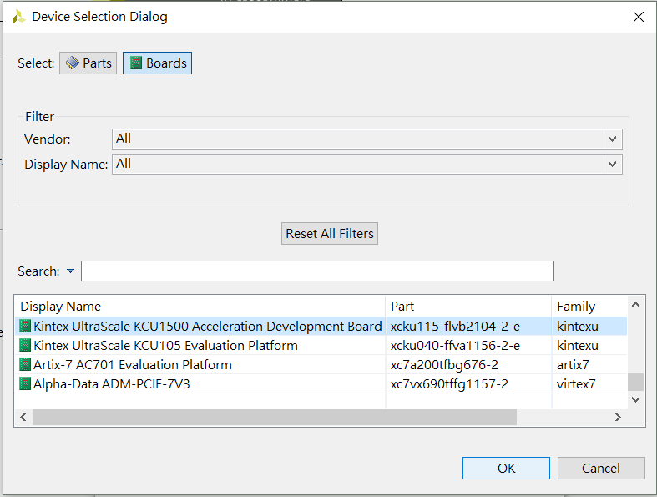
Step0: set solution name, select part: KU1500, click finish

Slide 9
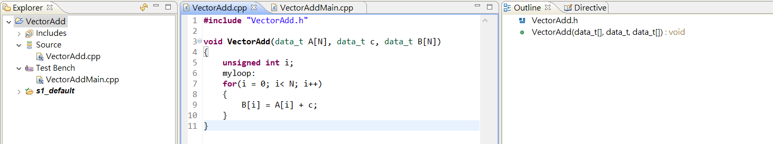
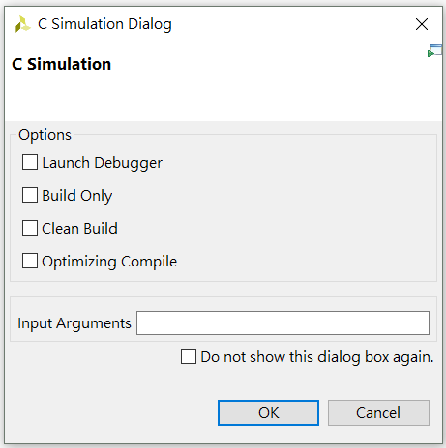
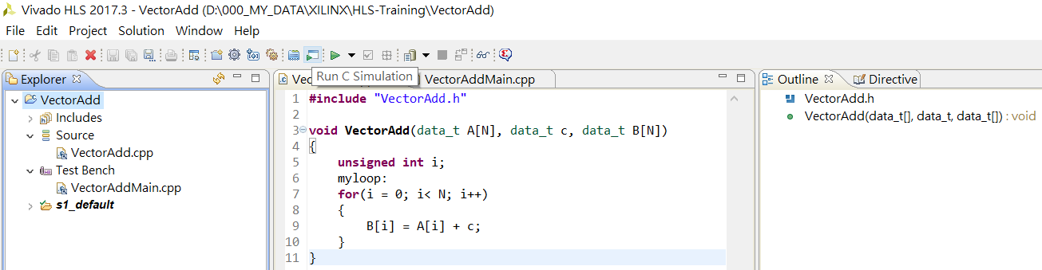
Step0: start Project
Step0: Run C Similation, then click OK

Slide 10
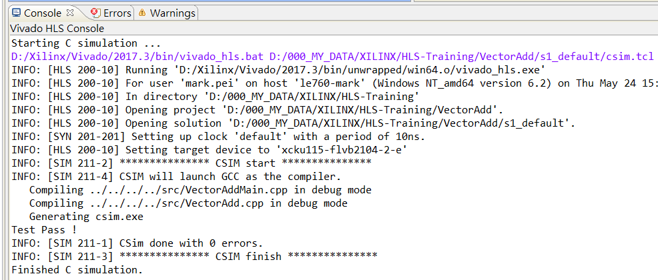
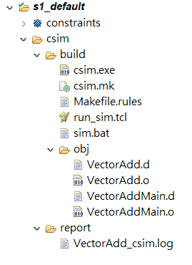
Step0: Build result console

Slide 11
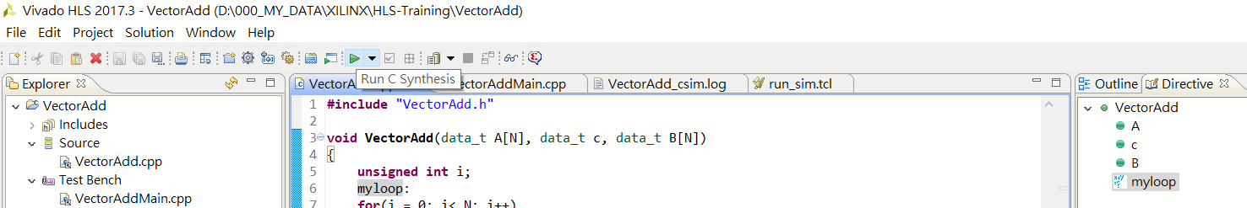
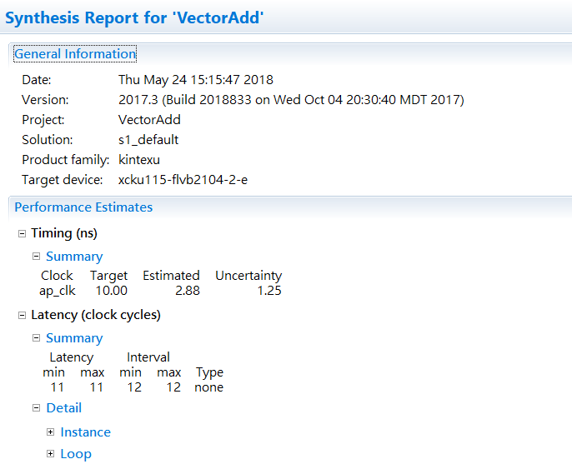
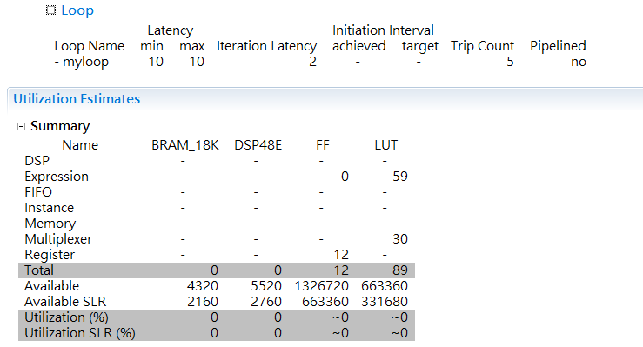
Step0: Run C Synthesis

Slide 12
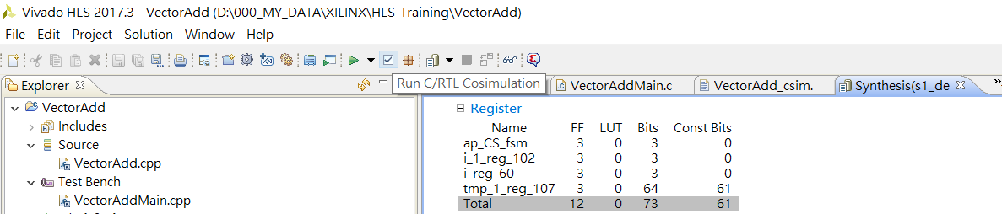
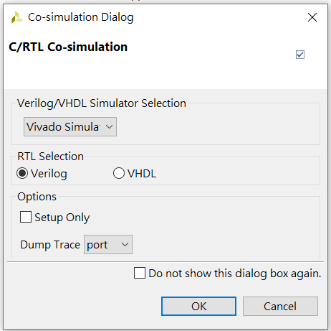
Step0: Run C/RTL Cosimulation, select Vivado Simula, Verilog
Click OK

Slide 13
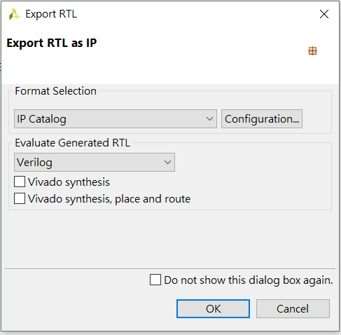
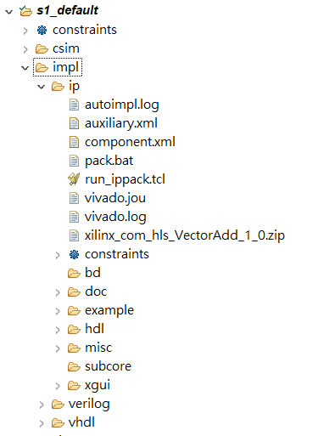
Step0: Export RTL as IP

Slide 14
Step0:

